Slide 1


Special topics
Session 5
Al-Zahra university
Maryam zim
@maryamzim maryamxiim@gmail.com

Slide 2
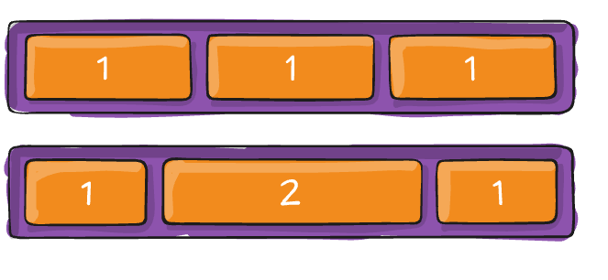

Flex items:
Flex Items are the direct children of a Flex Container (display: flex). The properties applied directly to these items control their individual sizing, alignment, and order within the container, overriding the container's default settings where applicable.
1- flex-grow:
This defines the ability of a flex item to grow if there is extra space remaining in the container (along the main axis).
Value: A unitless number.
Default: 0. The item will not grow beyond its content size.
Behavior: If all items have flex-grow: 1, they share the extra space equally. If one item has flex-grow: 2 and the others have 1, the item with 2 will take twice as much extra space as the others.

Slide 3
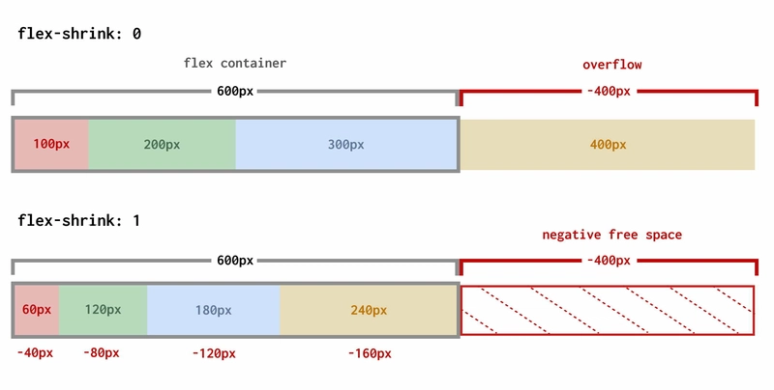
Flex items:
2- flex-shrink:
This defines the ability of a flex item to shrink if there is not enough space in the container (along the main axis).
Value: A unitless number.
Default: 1. The item will shrink proportionally if needed.
Behavior: A value of 0 prevents the item from shrinking at all, potentially causing overflow if the total width of all items exceeds the container's width.

Slide 4
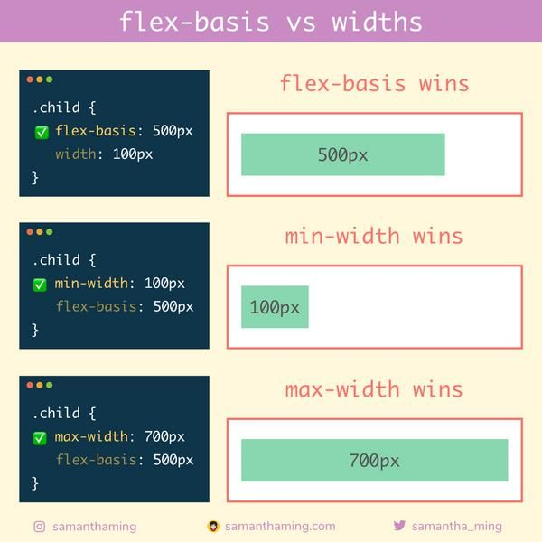
Flex items:
3- flex-basis:
This defines the initial size of a flex item before the remaining space is distributed according to flex-grow and flex-shrink.
Value: A length unit (e.g., 100px, 20%) or the keyword auto.
Default: auto. The initial size is based on the item's content size or any explicitly set width/height.
Behavior: If set to a specific length, it acts as the starting size from which the browser calculates growth or shrinkage.
Flex-basis vs width:

Slide 5
Flex items:
4-flex (Shorthand):
The flex property is a shorthand for setting the three sizing properties together: flex-grow, flex-shrink, and flex-basis (in that specific order).
Syntax: flex: <flex-grow> <flex-shrink> <flex-basis>;
Example: flex: 1 1 200px; (Grows 1x, Shrinks 1x, Initial size 200px)
Shorthand | Expands to... | Description
flex: auto; | 1 1 auto | Item can grow and shrink from its content size.
flex: none; | 0 0 auto | Item maintains its content size and cannot grow or shrink.
flex: 1; | 1 1 0; | Item can grow and shrink, and its base size is considered 0, forcing the extra space to be evenly divided.

Slide 6
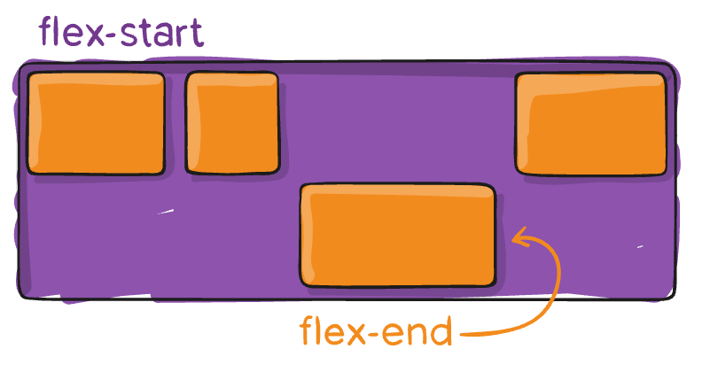
Flex items:
4-align-self:
This property allows a specific flex item to override the container's align-items property (alignment along the cross axis).
Value: Accepts the same values as align-items (flex-start, flex-end, center, stretch, baseline).
Use: Perfect for centering one element vertically while the rest of the items align to the start.

Slide 7
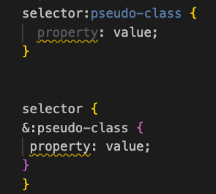
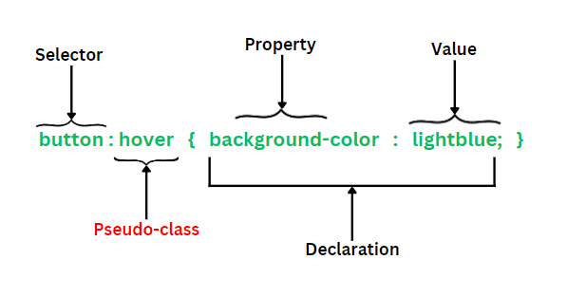
Pseudo class:
A pseudo-class is a keyword added to a CSS selector that specifies a special state of the selected HTML element. They allow you to apply styles based on factors other than the simple name, ID, or class of the element, such as its interaction state (e.g., being hovered over) or its position within a document tree (e.g., being the first child).
Pseudo-classes begin with a single colon (:) and are attached directly to a selector.
This is pseudo class syntax :

Slide 8
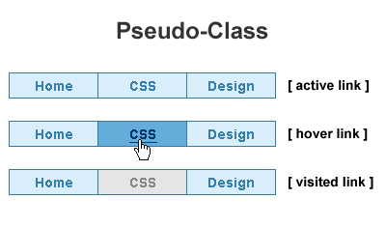
Pseudo class
Pseudo-class | Description | Example Use
:hover | Applies styles when the user's mouse pointer is over the element. | a:hover { color: red; }
:active | Applies styles when the element is being clicked or activated. | button:active { background: gray; }
:visited | Applies styles to links that the user has already visited. | :visited

Slide 9
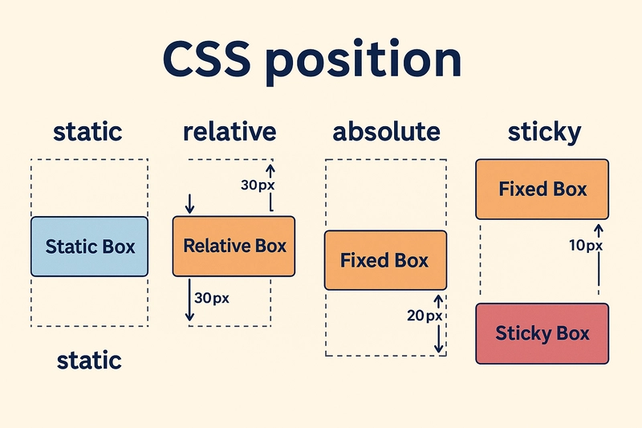
Position:
The position CSS property defines how an element is positioned on a web page, specifying the element's position relative to its normal flow, its parent element, or the viewport (the browser window).
Once the position is set to anything other than static, you use the offset properties (top, right, bottom, and left) to precisely control the element's final location.

Slide 10
Values of Position:
1. static (Default):
Behavior: Elements are rendered in the normal document flow as they appear in the HTML.
Offset Properties: top, right, bottom, and left have no effect when position is static.
Use: This is the default state for every element.
2. relative:
Behavior: The element is positioned according to the normal flow, but is then offset from its original position based on the top/right/bottom/left values.
Flow: The space the element originally occupied remains reserved; subsequent elements do not move into its initial space.
Use: Often used as a positioning context for absolutely positioned children (see absolute).
3. absolute:
Behavior: The element is completely removed from the normal document flow and placed relative to its nearest positioned ancestor (any ancestor whose position is not static).
Flow: The space the element originally occupied is collapsed, and subsequent elements behave as if the element was never there.
Context: If no positioned ancestor is found, it positions itself relative to the initial containing block (usually the <html> element or the viewport).
Use: Ideal for tooltips, modals, dropdowns, and components that need precise placement over other content.

Slide 11
Values of Position:
4. fixed:
Behavior: The element is completely removed from the normal document flow and positioned relative to the viewport (the browser window).
Scroll: The element stays in the same place even when the page is scrolled.
Use: Commonly used for creating persistent navigation bars, side menus, or "Back to Top" buttons that must remain visible.
5. sticky:
Behavior: This is a hybrid. The element is treated as relative until it reaches a specified offset (e.g., top: 0), at which point it becomes fixed relative to the viewport.
Use: Perfect for creating headers that "stick" to the top of the viewport after the user scrolls past them, but only within their parent container. Requires specifying at least one offset property (top, right, bottom, or left) to define the sticking point.

Slide 12
Values of Position:
Position Value | Reference Point | In Flow? | Offset Properties (top/left...) | Typical Use
static | Normal document flow | Yes (Default) | No Effect | Standard element placement.
relative | Original position | Yes (Space reserved) | Offsets from original spot. | Minor positional adjustments; setting a context for absolute children.
absolute | Nearest positioned ancestor (or viewport) | No (Removed) | Positions relative to the ancestor/viewport. | Tooltips, dropdowns, and components placed precisely over content.
fixed | Viewport (Browser window) | No (Removed) | Positions relative to the viewport. | Persistent navigation bars or "Back to Top" buttons that scroll with the page.
sticky | Viewport (after scrolling) | Yes (Default is relative) | Defines the "sticking" point (e.g., top: 0). | Table headers or section titles that remain visible while scrolling through content.

Slide 13
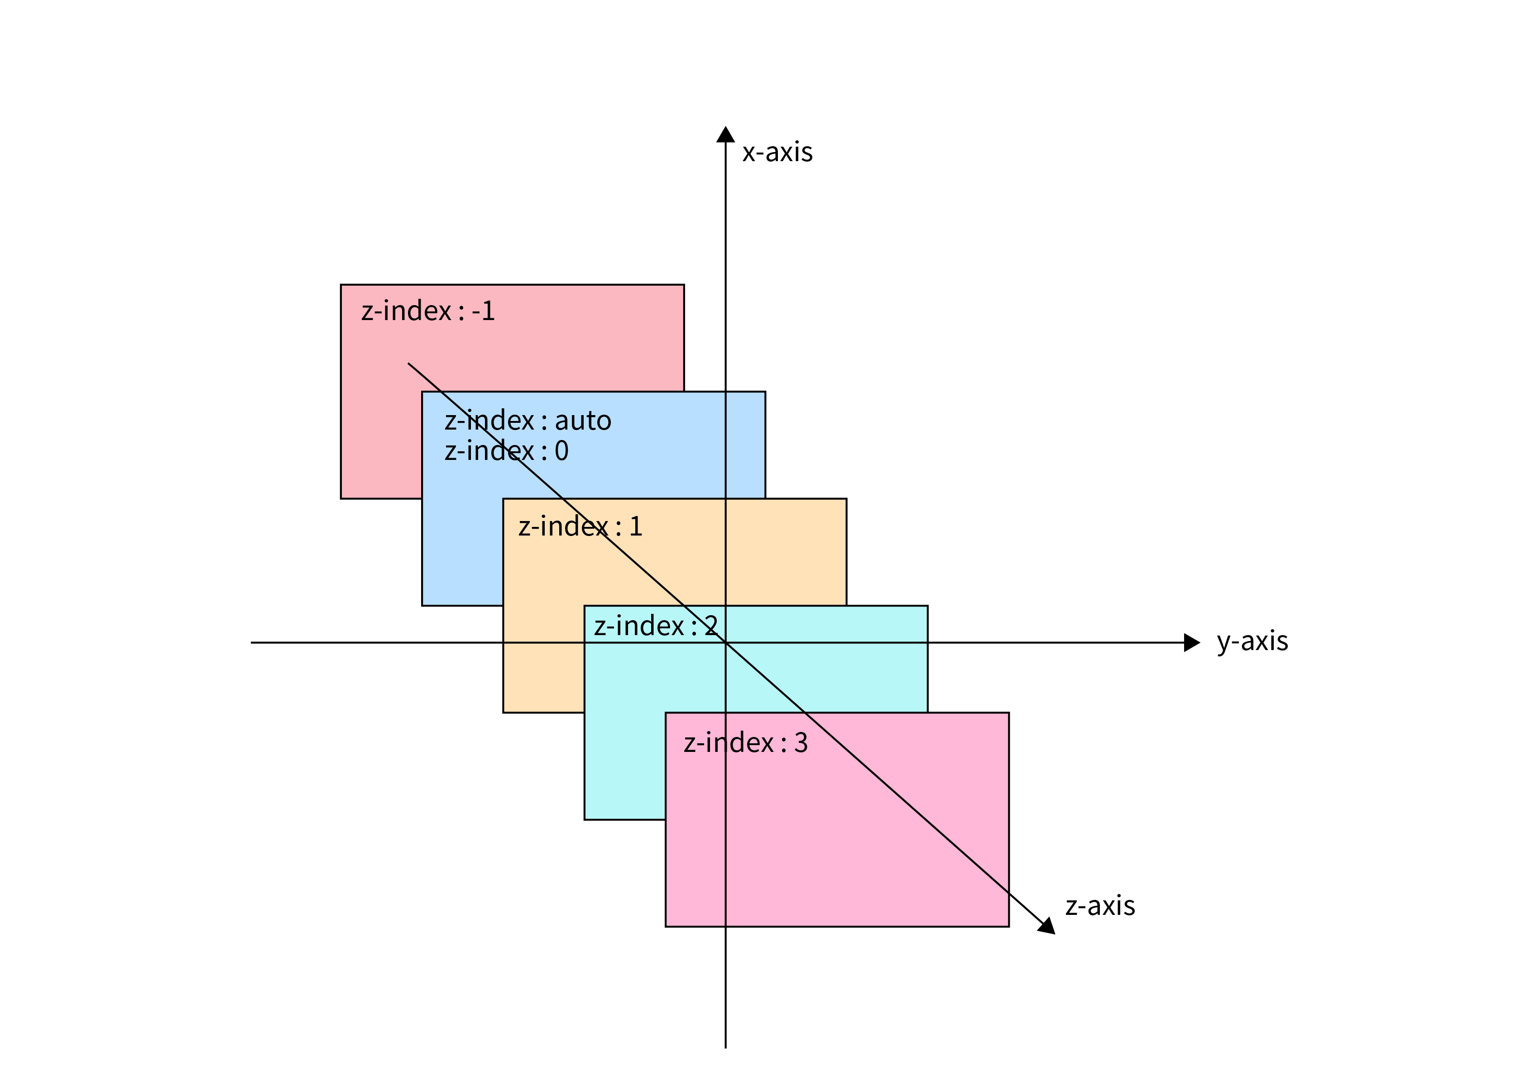
Z-index:
The z-index property in CSS controls the stacking order of positioned elements. It determines which element appears in front of or behind other overlapping elements on the z-axis (the axis coming out of the screen towards the user).

Slide 14
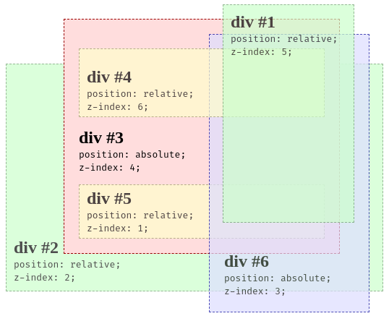
Rules for z-index
Requires Positioning: z-index only works on elements that have their position property set to something other than the default value of static .
Higher Number, Higher Stack: Elements with a higher z-index value are placed closer to the user (on top) than elements with a lower value.
No Units: The value for z-index is a unitless integer (e.g., 1, 10, 1000). It can be positive, negative, or zero.

Slide 15
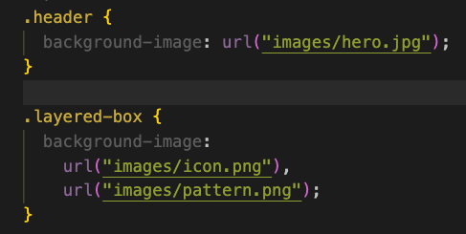
Background-image:
The background-image CSS property is used to set one or more background images for an element. This property does not replace the content of the element; instead, it places the image behind the element's content, padding, and border.
Tip: Background images are decorative; they are not part of the document's content. They are typically ignored by screen readers and don't affect the document's structure.
Syntax and Example:
The value for background-image is typically a url() function pointing to the image file.

Slide 16
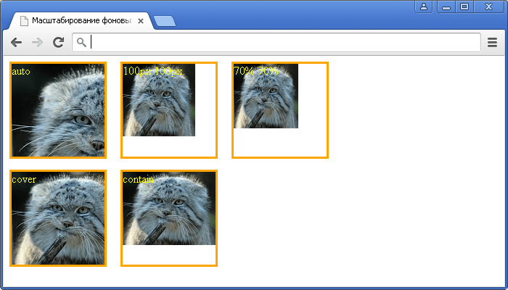
Background properties:
The background-image property is rarely used alone. It is typically combined with other background properties to control how the image is displayed:
Background-size:
Property | Purpose
background-repeat | Defines if and how the image is tiled (e.g., no-repeat, repeat-x, repeat-y).
background-position | Sets the starting position of the background image (e.g., center, top right, 20px 50%).
background-size | Specifies the size of the background image (e.g., cover, contain, 100% auto).
background (Shorthand) : | color image repeat position size;

